Slide 1

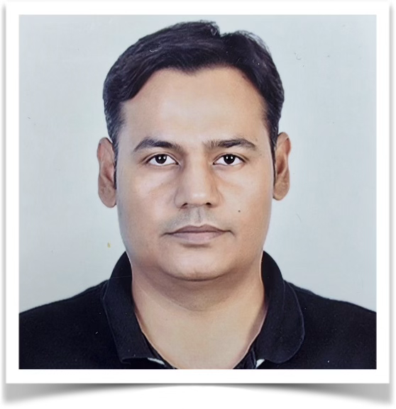



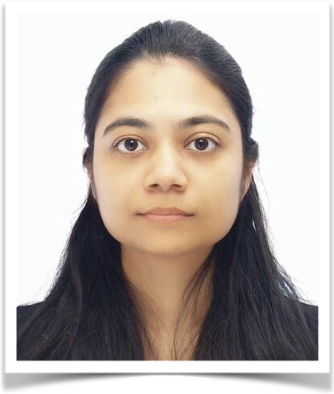
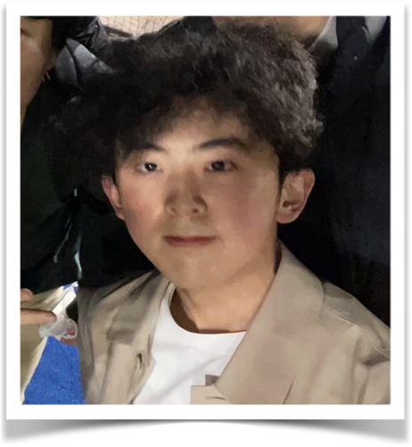
MIZU
(Monitoring of Irrigation Zones Using satellites & IoT)
Phanish
Ojas
Shohei
Joseph
Debrupa
Yuzuki
Supporters

Slide 2
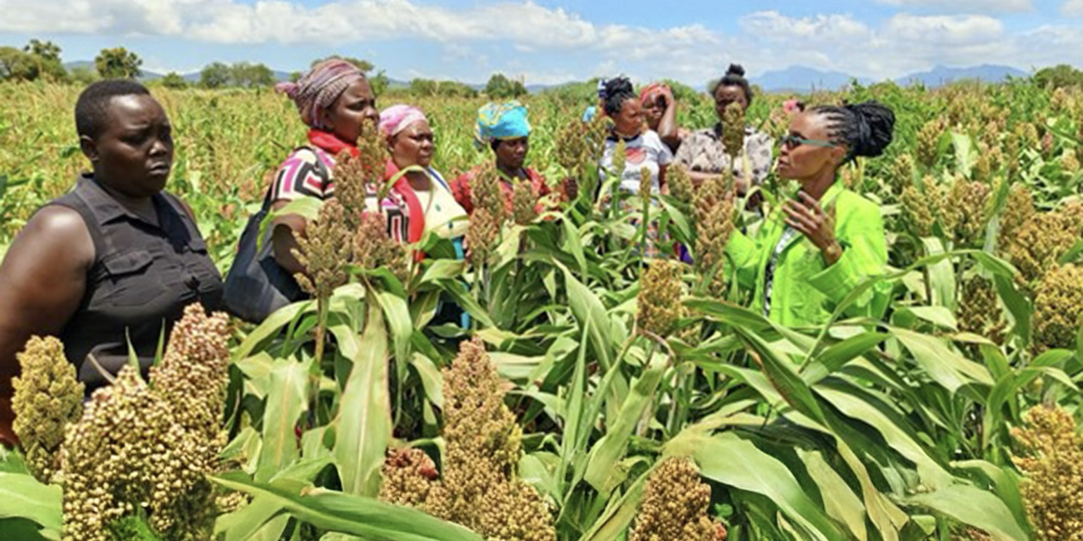
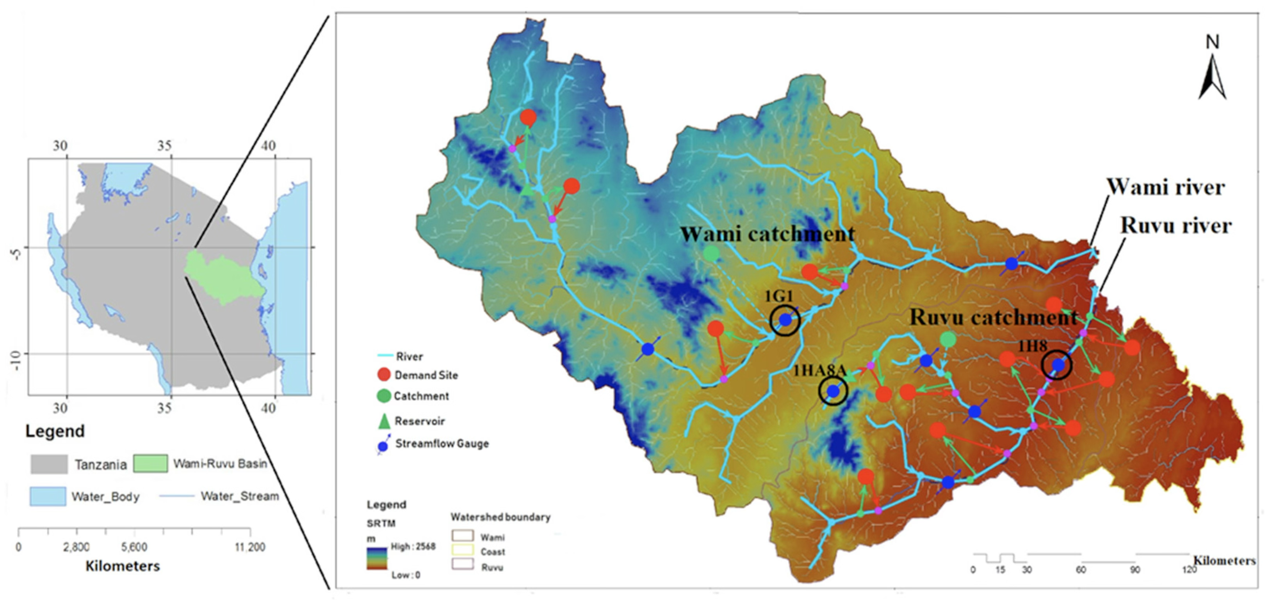
1. User Needs/Background
Proper water resource management is essential for agriculture.
➢ For example, rice irrigation in dry season is a challenge in Kenya and Tanzania.
Proposed solution steps:
1. Rainfall prediction from weather data using IoT sensor
2. Soil moisture monitoring using IoT sensor
3. Irrigation optimization
Most of Kenyan land is semi-arid
Rice irrigation in Tanzania

Slide 3
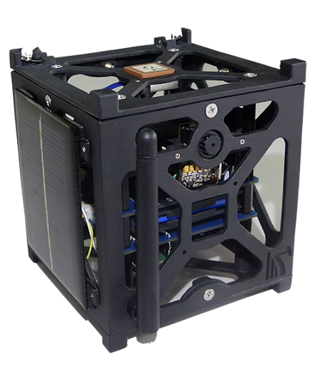
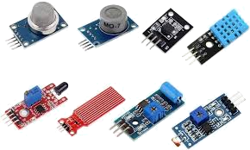
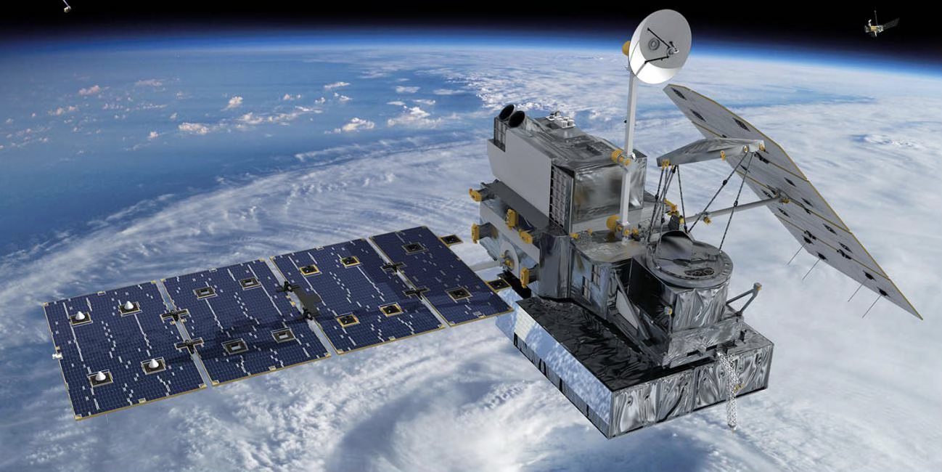
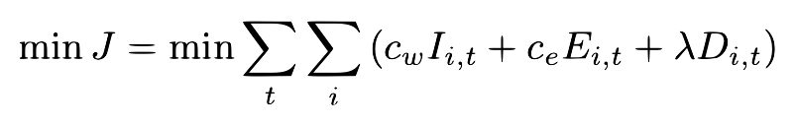
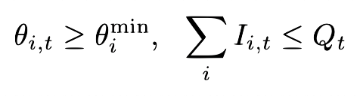
1. User Needs/Background
IoT sensor data
Temperature, humidity, wind,
solar radiation, soil moisture, soil temperature, rain gauge*, surface moisture*, leaf wetness*
Satellite rainfall data
(IMERG, CHIRPS)
SWAT model
(Hydrology
model)
Precipitation Forecasting with Data Assimilation (Ensemble Kalman Filter)
Precise rain fall prediction
Precise
evapotranspiration
Irrigation optimization
Constrained Model Predictive Control
Objective
function
Constraints
IoT & Satellite can be used for optimal water irrigation

Slide 4
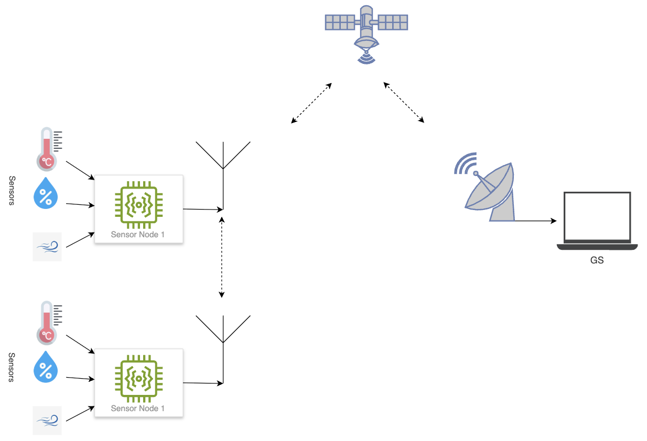


2. Mission Goal/Objective
[MG-1] Uplink the weather and agricultural data from IoT sensors to satellites
[MG-2] Downlink the stored data from satellites to ground stations
Concept sketch
Satellite
IoT sensors
(network unavailable areas)
Ground station
End users (farmers)

Slide 5
3. Success Criteria
[MG-1] Uplink the weather and agricultural data from IoT sensors to satellites
[MG-2] Downlink the stored data from satellites to ground stations
Success Level | No. | Mission Success Criteria | Verification Method
Minimum Success | [MG-1] | Acquire data from various sensors | Acquired data from the sensors is displayed on the terminal
 | [MG-2] | Aggregate the sensor data and transmit them to the Satellite | Transmitted data is displayed on the terminal connected to the HEPTASAT
Full Success | [MG-1] | Received aggregated data transmitted to the ground station | Aggregated data displayed on the Ground Station Terminal
Advanced Success | [MG-2] | The ground station decompose the aggregated data and display the results on the ground station interface | Various sensor data is displayed on the Ground Station interface
Advanced Success | [MG-1] | Aggregate data from multiple sensor nodes and uplink the data to the satellite | Decompose data from multiple sensors and display on the HEPTASAT Terminal
 | [MG-2] | Relay the aggregated data to the second HEPTASAT to form a constellation of satellites | Receive the data from HEPTASTA1 to HEPTASAT2

Slide 6
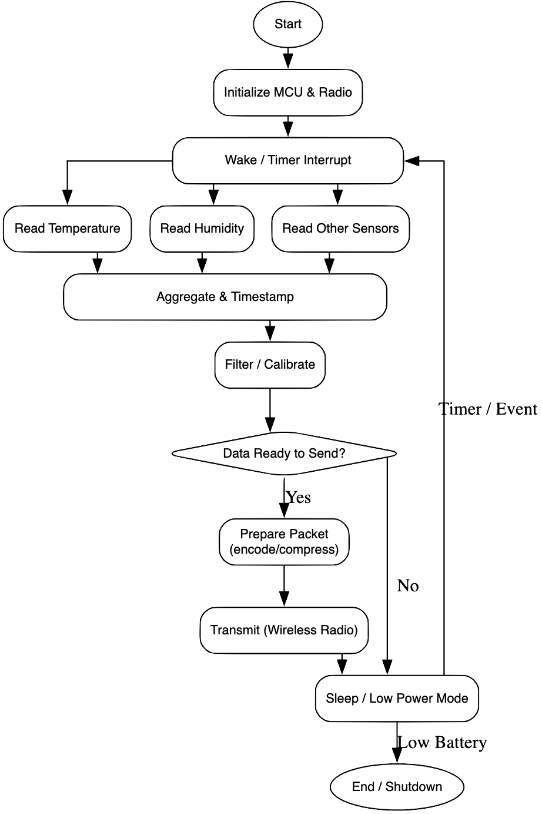
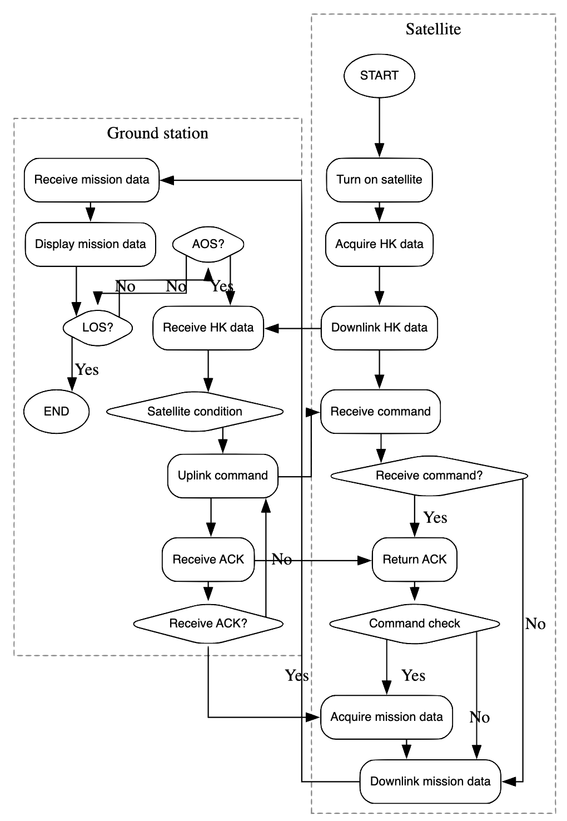
4. Mission Sequence
Sensors
Satellite
Ground station

Slide 7
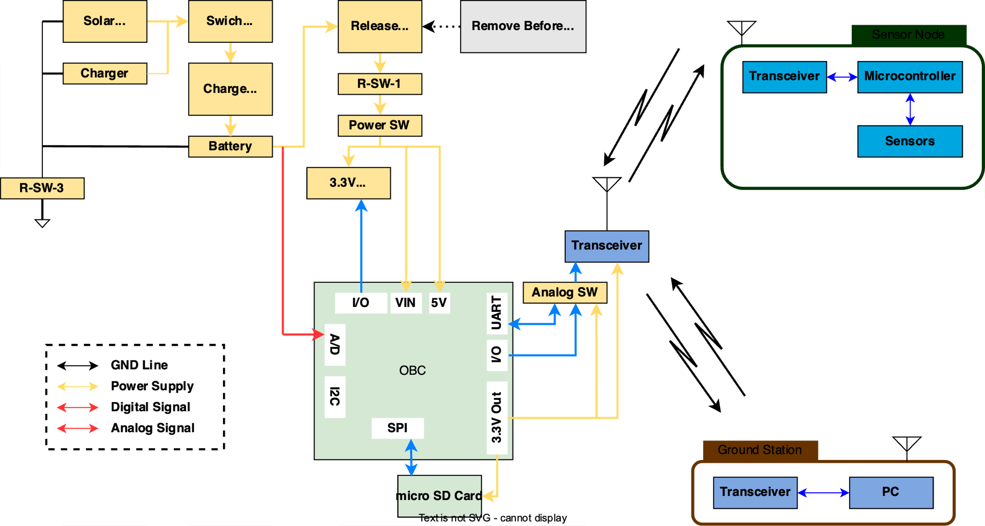
5. Block Diagram

Slide 8
6. Components
No.​ | Components​ | Model Number​ & URL​ | Where to get​ | Qty​ | Unit Price​ (Tax 10%)​ | Total​
1​ | Temperature and Humidity Sensor | ST0248 | Provided | 2 | 0 | 0
2​ | Wind Speed Sensor |  | Provided | 2 | 0 | 0
3 | Solar Radiation Sensor 1 (Ambient light sensor) | TEMT6000 | Provided | 2 | 0 | 0
4 | Solar Radiation Sensor 2 (UV sensor) | Grove-UV | Provided | 2 | 0 | 0
5 | Soil Moisture | SEN0114 | Akizuki | 2 | 550 | 1100
6 | Soil Temperature sensor (Hepta-sat temp. sensor) |  | Provided | 2 | 0 | 0
7 | GPS sensor |  | Provided | 2 | 0 | 0
8 | Mbed Board | LPC1768 | Provided | 2 | 0 | 0
​ | Total (JPY)​ | ​ | ​ | ​ | ​ | 1,100

Slide 9
7. Schedule Management Result
Action Item | Person in charge | Day 1 |  |  |  | Day 2
 |  | 9 | 12 | 15 | 18 | 9 | 12 | 15 | 18
Sensor Verification | Phanis/Ojas
development of GS | Joseph
System integration and verification Satellite System | Shohei
Prepare final presentation | All

